Slide 1
PROJECT #11-HangMan Continental Entry Training Program Danca Alexandra-Simona

Slide 2
Content
SW Requirements
SW-SYS Architecture
Challenges
SW Tests

Slide 3
SW Requirements

Slide 4
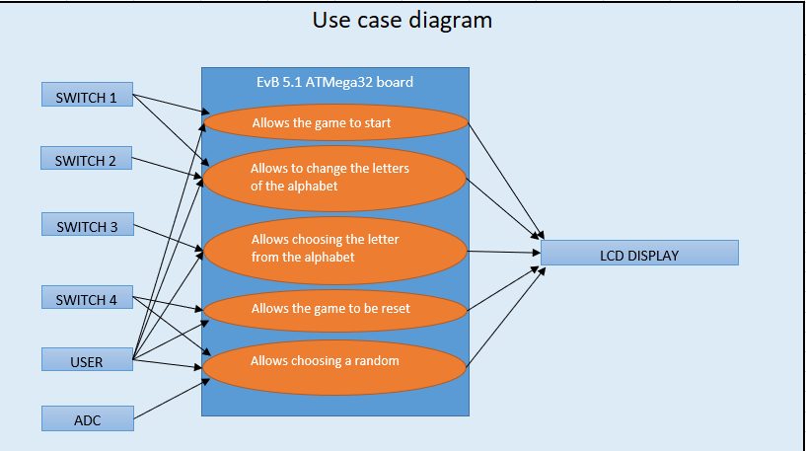
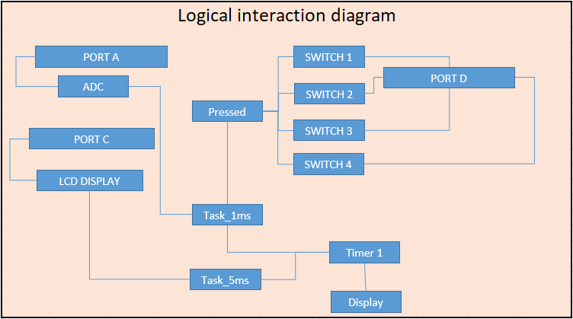
SW-SYS Architecture

Slide 5
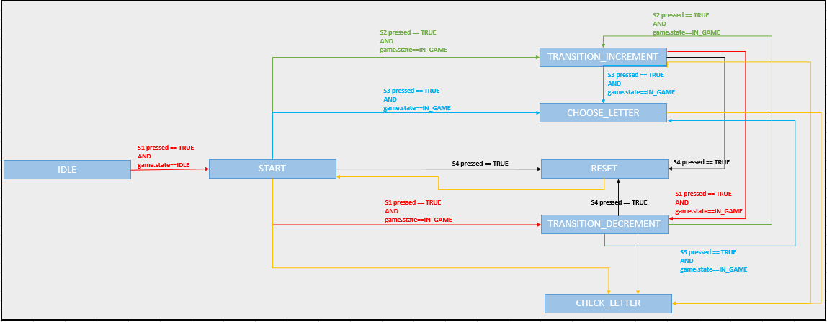
SW-SYS Architecture

Slide 6
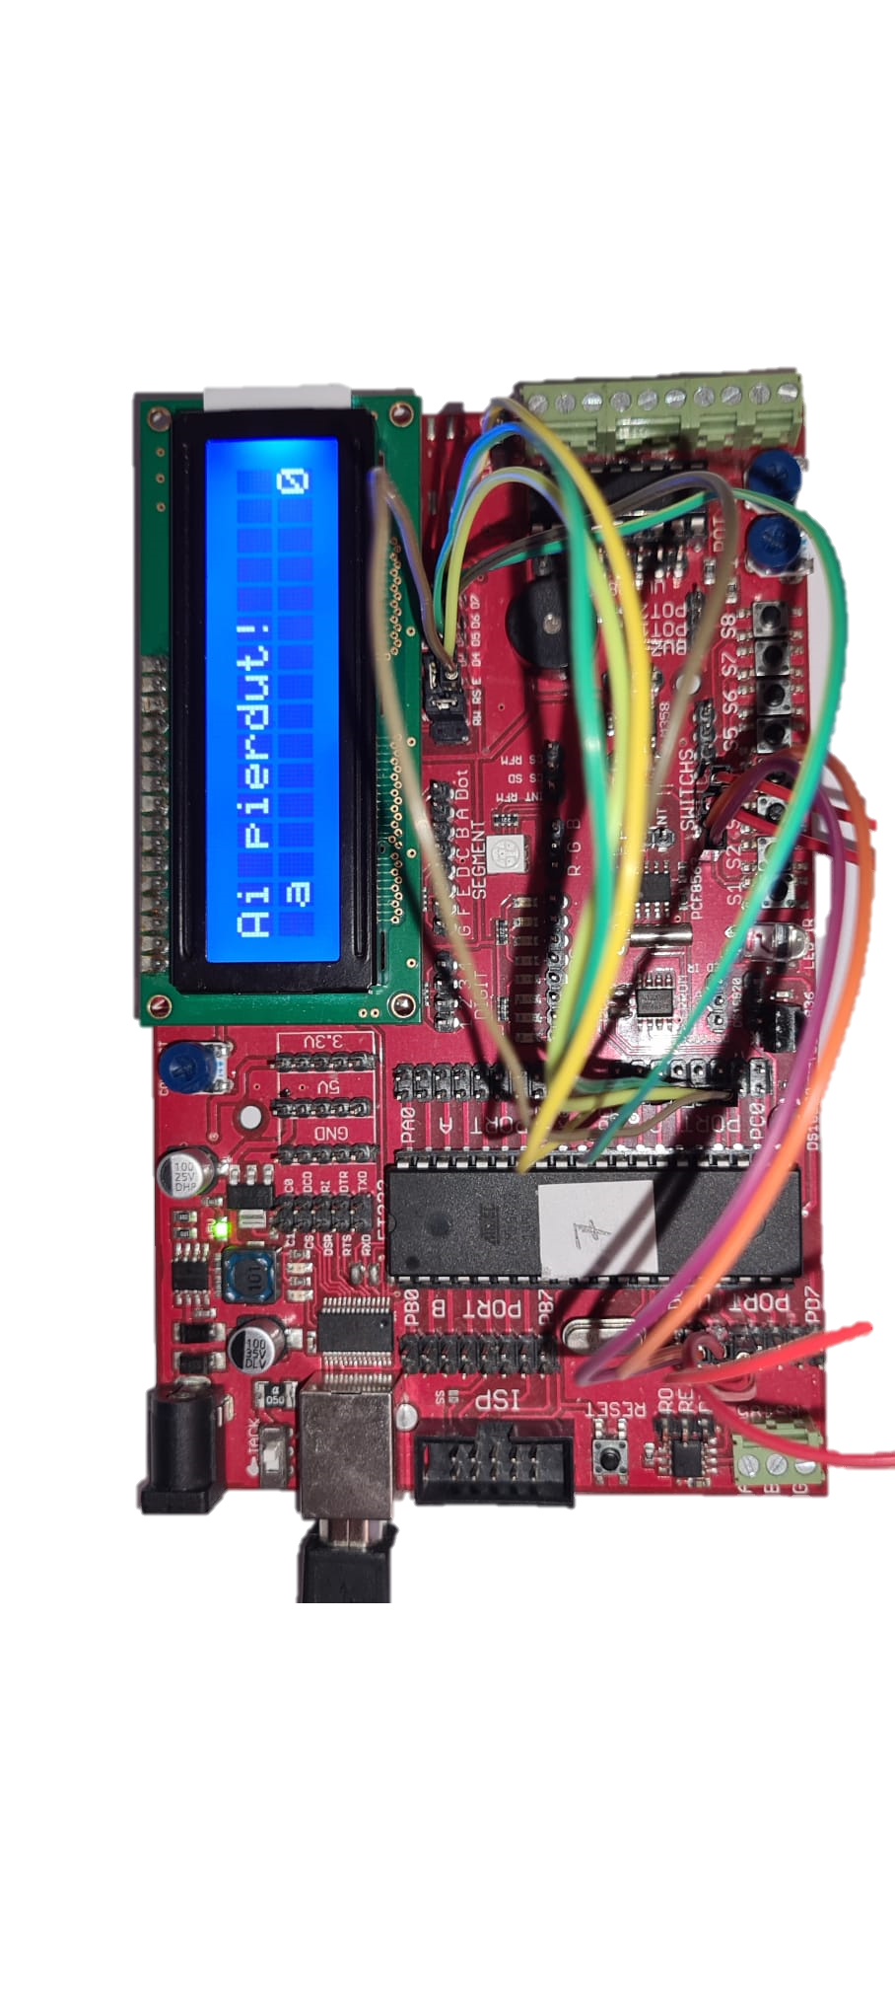
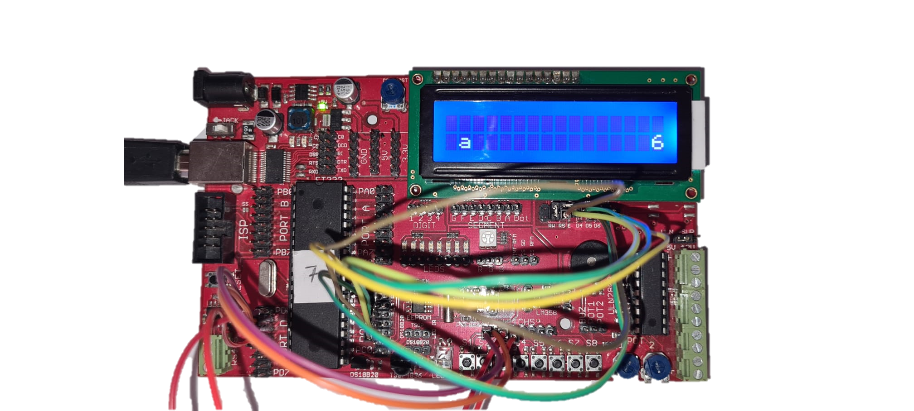
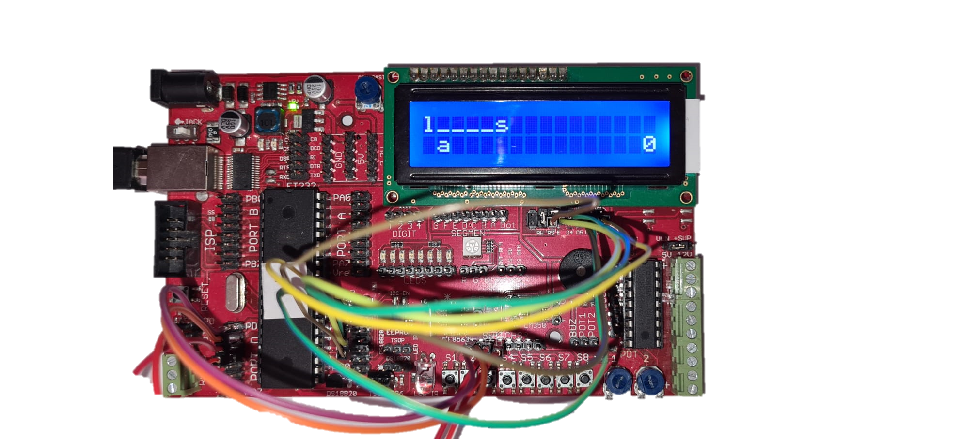
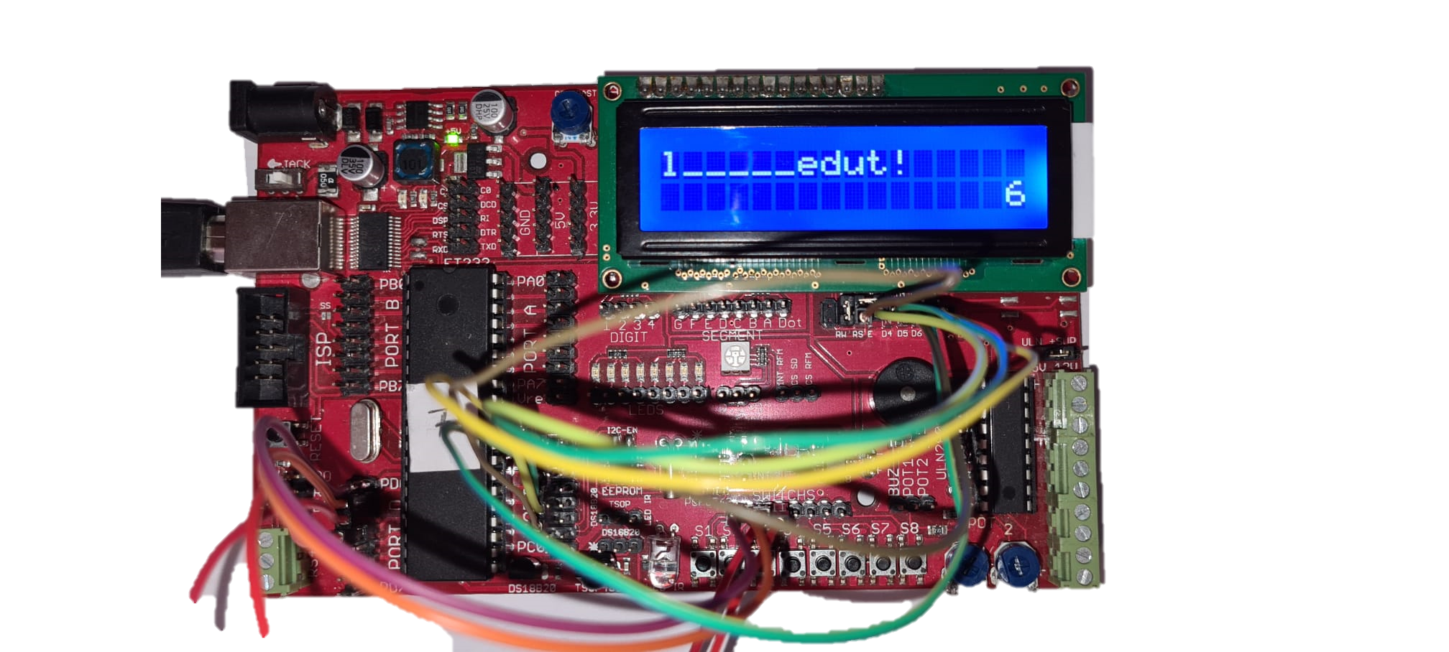
Challenges

Slide 7
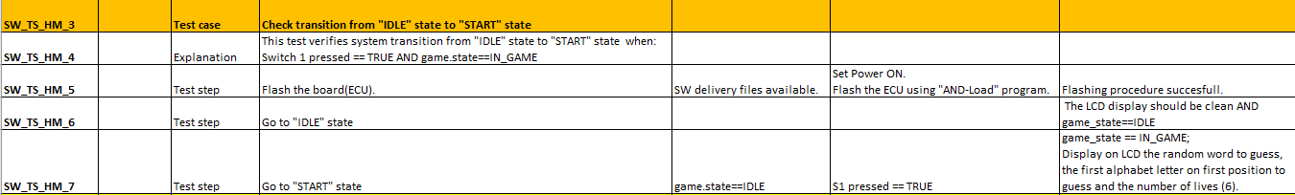
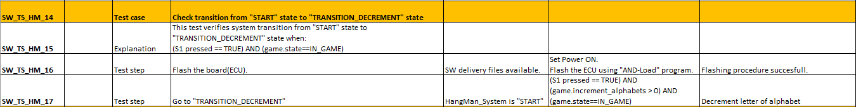
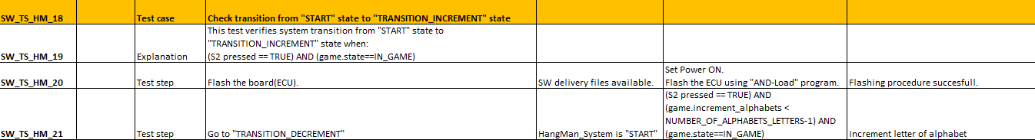
SW Tests

Slide 8
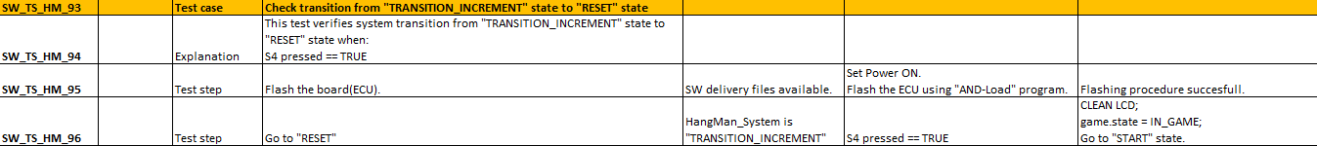
SW Tests

Slide 9
Thank you!

